Slide 1

Unit 10

Slide 2
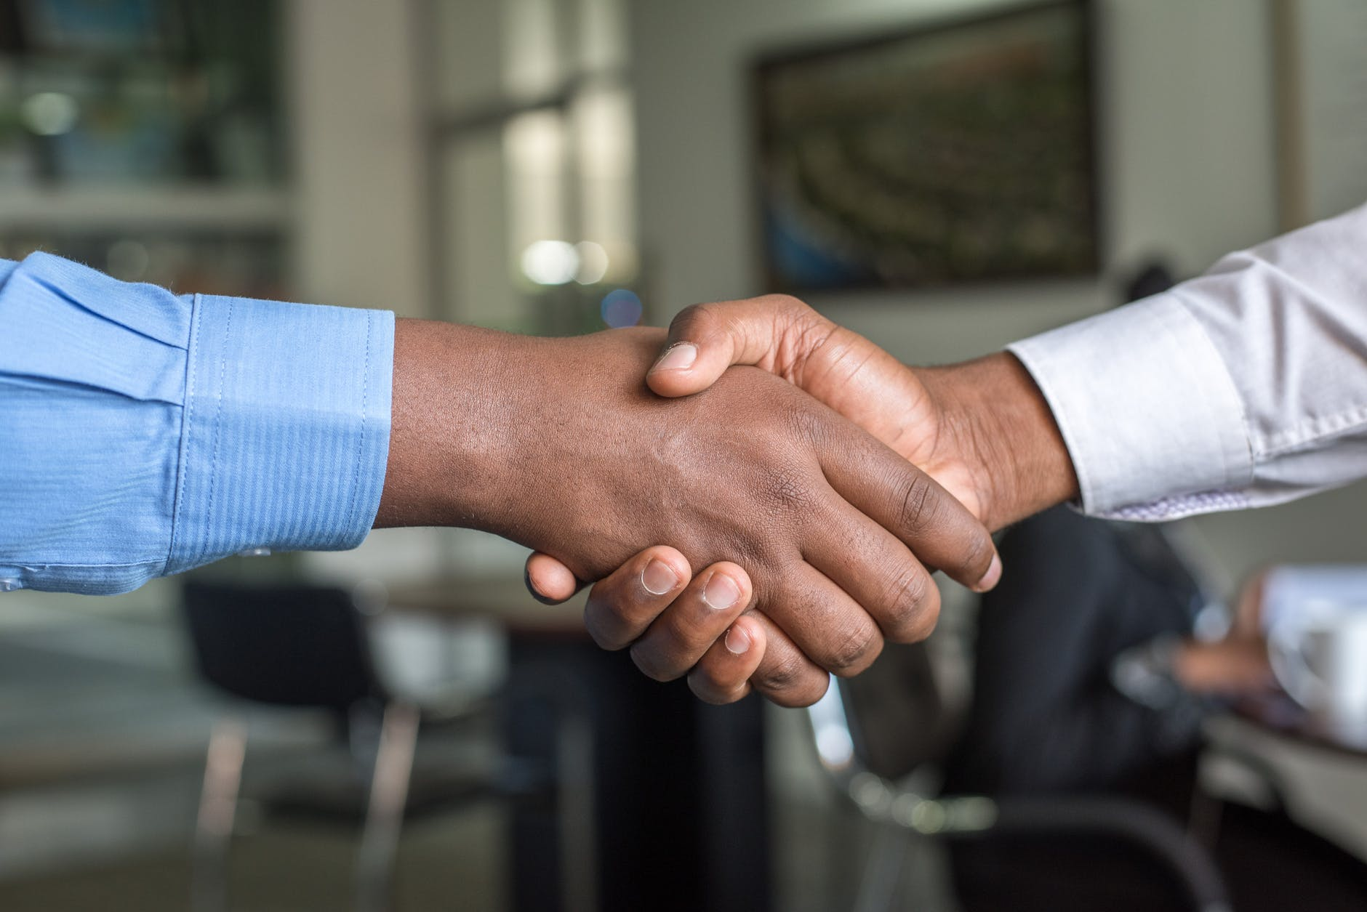
Unit 10
You're supposed to shake hands.

Slide 3



Slide 4



To learn to write a letter to give your pen pal advice and suggestions on how to behave properly in China.
To check yourself.

Slide 5


Customs in different countries.
 | China | France | …
meet for the first time
be on time
visit friends
table manners
…

Slide 6

Your pen pal is coming to China on an exchange program. He/She is asking you about Chinese customs and what he/she is supposed to do or not. Make notes in the chart.
3a
Table manners | It’s polite/impolite to…
House rules | You’re supposed/not supposed to…
Going out with people | You should…

Slide 7
Table manners
Chinese customs
It’s polite to ask older people to start eating first at the table.
It’s impolite to pick up your bowl to eat.
You’re supposed to use chopsticks to eat.
It’s not polite to stick your chopsticks into your food.

Slide 8
It’s impolite to point at anyone with your chopsticks.
It’s impolite to knock your empty bowl with your chopsticks.
…

Slide 9
House rules
◆ You’re supposed to greet the host family.
◆ You’re supposed to shake hands with people.
◆ You’re supposed to say “Nihao” to people.
◆ You’re not supposed to kiss or hug with people.
◆ …

Slide 10
Going out with people
You should call first.
You should make a going-out plan with friends.
…

Slide 11


Slide 12

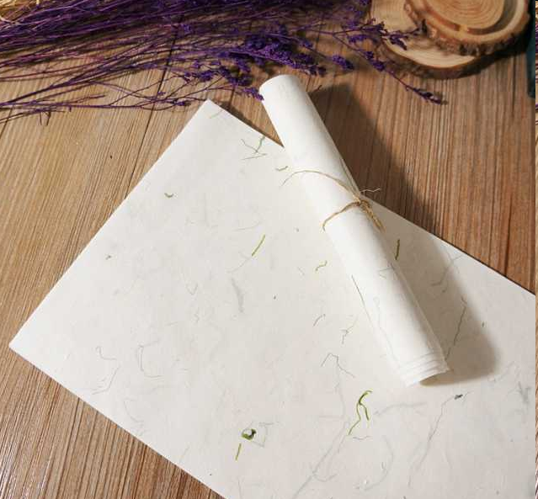

Write a letter to your pen pal to give him/her advice and suggestions on how to behave properly in China.
3b

Slide 13
写作指导
书信的写法：
称呼Dear…， 左起顶格。
正文换行顶格，是信的核心部分。正文层次分明、简单易懂。
祝福话语在正文下换行顶格写， 如: Best wishes! Take care! Happy New Year! Happy Birthday!等。

Slide 14
结束语在正文下的一、二行处，第一个词开头大写，句末用逗号。如：Yours, Your loving…, Sincerely yours, Yours sincerely或Sincerely；在结尾语下面的署名亲自签名，不加标点符号。

Slide 15

文化礼仪常用句型：
You’re (not) supposed to….
You are expected to…
It’s polite/impolite to…
It’s important to…
You should….

Slide 16

Dear Tony,
You must be excited about coming to China soon. Let me give you some suggestions and advice about Chinese customs. When you are eating at the table, it’s impolite to start eating first if there are older people at the table. You should let them start first.

Slide 17
When you are eating with chopsticks, it is impolite to point at anyone with your chopsticks. It is also impolite to stick your chopsticks into the bowl of rice and leave them there.
In our house, you’re supposed to take off your shoes before you enter the house or just inside the front door. In our culture, we don’t usually hug or kiss people.

Slide 18
When you go out with people, you should tell the hostess where you are going, who you are going with and when you will come back. In our culture, the hostess will worry a lot about the safety of her guests, so a polite guest will always let her know these things.
Have a safe trip, and I look forward to meeting you soon!
Best wishes,
Xiao Wei

Slide 19


1. Fill in the blanks with the words in the box.
worth capital basic traffic
empty mad knocking

Slide 20
worth capital basic traffic
empty mad knocking
1. In many countries, it is impolite to show up at someone’s house for the first time with ______ hands. You should always bring a small gift.
2. Billy was very uncomfortable at a fine-dining restaurant last night because he didn’t know ______ table manners.
empty
basic

Slide 21
worth capital basic traffic
empty mad knocking
worth
3. It is _______ spending the time to learn about the customs of a country before you go there. That way, you will know what you are supposed to do in different situations.
4. The ______ is always the worst in the ________ city. It is important to leave earlier if you are traveling by car.
traffic
capital
5. Sandy went into her sister’s room without _________ on the door. That made her sister ______.
knocking
mad

Slide 22
2. Think about your culture and make statements.
In my culture, when you…
you’re supposed to ____________
you’re not supposed to _________
you’re expected to _____________
it’s impolite to ________________
it’s important to ______________

Slide 23
In my culture, when you ____________
__________________________________
you’re supposed to _________________
__________________________________
you’re not supposed to ______________
__________________________________
are having a
meal in someone’s home,
allow the elderly to
start eating first.
stick your
chopsticks into a bowl of rice.

Slide 24
you’re expected to __________________
________________________
it’s impolite to _____________________
__________________
it’s important to ___________________
______________________
keep your mouth closed when you are chewing.
reach across the table to pick certain foods.
ask for permission to leave the table early.

Slide 25


Ⅰ. 根据括号内的要求完成下列各题。
1. The party at Andy’s house last night was very wonderful. (对划线部分提问)
_________ _________ the party at Andy’s house last night?
2. Tom gave me a good suggestion. (用some将句子改为复数句)
Tom gave me _________ _________ _________.
3. The boy should get to the cinema at 7:00 this evening. (改为同义句)
The boy _________ _________ _________ get to the cinema at 7:00 this evening.
How was
some good suggestions
is supposed to

Slide 26
4. My pen pal always feels good about speaking Chinese. (改为同义句)
My pen pal _________ _________ _________ speaking Chinese.
5. 请当心碰头！ (完成译句)
_________ _________ _________, please!
6. 你绝不会相信他按时完成了所有的工作！ (完成译句)
_________ _________ _________ that he finished all the work on time!
is always comfortable
Mind your head
You wouldn’t believe

Slide 27
Ⅱ.阅读短文，从方框中选择恰当的词填空。
custom, capital, greet, mad, season, gradually, except
Dear Jason,
How are you in Australia? Now I’m in Beijing, the (1)_________ of China. At the moment it’s winter in Australia. It’s very cold. Different from Australia, it’s summer here, the second (2)_________ of the year. It’s very hot. As an exchange student, I’m learning Chinese in this beautiful city. In my class all the students are Chinese (3)_________ me. So in my class I felt nervous and worried at first.
capital
season
except

Slide 28
custom, capital, greet, mad, season, gradually, except
Gradually
(4)_________, I got used to the life here. And now I know lots of (5)_________ here. For example, when I meet my friend on the street, I usually (6)_________ him like this, “Hey, where are you going?” In our country if someone asks this, people may get (7)_________ but in this country people won’t. Of course, there are some other interesting things here. I'll tell you about them next time.
Yours,
Dale
customs
greet
mad

Slide 29


小组合作一张海报。把收集到的各国见面礼仪，餐桌礼仪，风俗习惯等信息制成海报。

Slide 30


